Slide 2
A Loving People
A Righteous People
A Unified People
An Obedient People
A Growing People
A Prayerful People

Slide 3
A Prayerful People
Philippians 4:4-7
Rejoice in the Lord always; again I will say, rejoice! 5 Let your gentle spirit be known to all men. The Lord is near. 6 Be anxious for nothing, but in everything by prayer and supplication with thanksgiving let your requests be made known to God. 7 And the peace of God, which surpasses all comprehension, will guard your hearts and your minds in Christ Jesus.

Slide 4
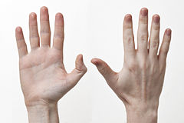
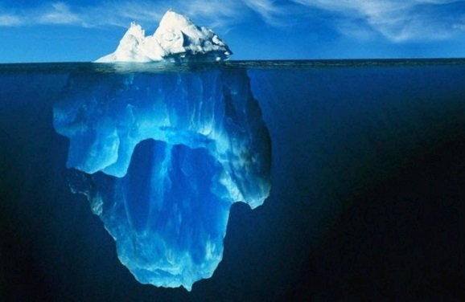
Attention
Action
Attitude

Slide 5
Attention
A Prayerful People
1 Thessalonians 5:17
pray without ceasing

Slide 6
Attention
A Prayerful People
1 Corinthians 14:15
What is the outcome then? I will pray with the spirit and I will pray with the mind also; I will sing with the spirit and I will sing with the mind also.

Slide 7
Action
A Prayerful People
1. Make time to pray

Slide 8
Action
A Prayerful People
Ephesians 6:18
With all prayer and petition pray at all times in the Spirit, and with this in view, be on the alert with all perseverance and petition for all the saints

Slide 9
Action
A Prayerful People
1. Make time to pray
2. Pray “deep” prayers

Slide 10
Action
A Prayerful People
Matthew 23:14
Woe to you, scribes and Pharisees, hypocrites, because you devour widows’ houses, and for a pretense you make long prayers; therefore you will receive greater condemnation.

Slide 11
Action
A Prayerful People
1. Make time to pray
2. Pray “deep” prayers
a. Avoid repetitive phrases

Slide 12
Action
A Prayerful People
Matthew 6:7
And when you are praying, do not use meaningless repetition as the Gentiles do, for they suppose that they will be heard for their many words.

Slide 13
Action
A Prayerful People
1. Make time to pray
2. Pray “deep” prayers
a. Avoid repetitive phrases
b. Create a list

Slide 14
Action
A Prayerful People
Matthew 7:8
For everyone who asks receives, and he who seeks finds, and to him who knocks it will be opened.

Slide 15
Action
A Prayerful People
1. Make time to pray
2. Pray “deep” prayers
a. Avoid repetitive phrases
b. Create a list
c. Make it personal

Slide 16
Action
A Prayerful People
1. Make time to pray
2. Pray “deep” prayers
a. Avoid repetitive phrases
b. Create a list
c. Make it personal
d. Pray in your own tongue

Slide 17
Action
A Prayerful People
1. Make time to pray
2. Pray “deep” prayers
a. Avoid repetitive phrases
b. Create a list
c. Make it personal
d. Pray in your own tongue
3. Ask for prayers

Slide 18
Action
A Prayerful People
James 5:16
Therefore, confess your sins to one another, and pray for one another so that you may be healed. The effective prayer of a righteous man can accomplish much.

Slide 19
Attitude
A Prayerful People
Luke 18:13
But the tax collector, standing some distance away, was even unwilling to lift up his eyes to heaven, but was beating his breast, saying, ‘God, be merciful to me, the sinner!’

